Slide 1


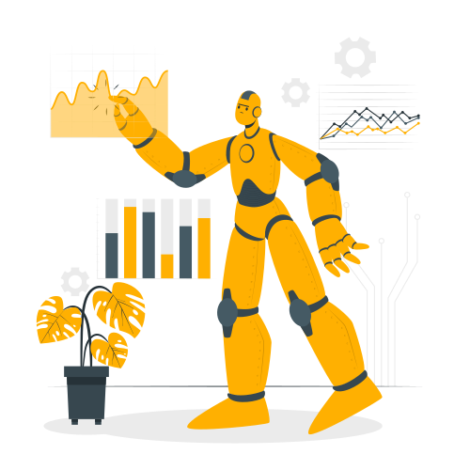

#free_palestine
First Session : Introduction
ELHARRAN AYOUB
ASKRI AYMANE
OCTOBER 26 2023

Slide 2


Plan
1
Introduction to AI
2
Programming Toolbox Tour
Web-Powered Projects:
Why We Will ?
3
4
Session Workflow
5
Unveiling Our First Project
6
Bonus Delight

Slide 3
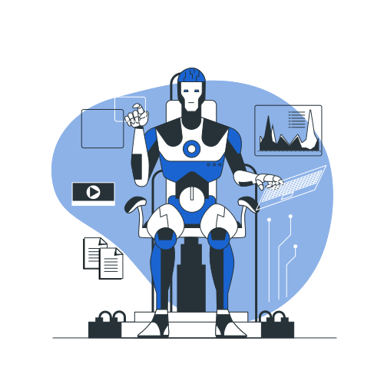

AI
ML
RL
AI ?!
DL
Artificial Intelligence is a branch of computer science that is concerned with building smart & intelligent machines

Slide 4
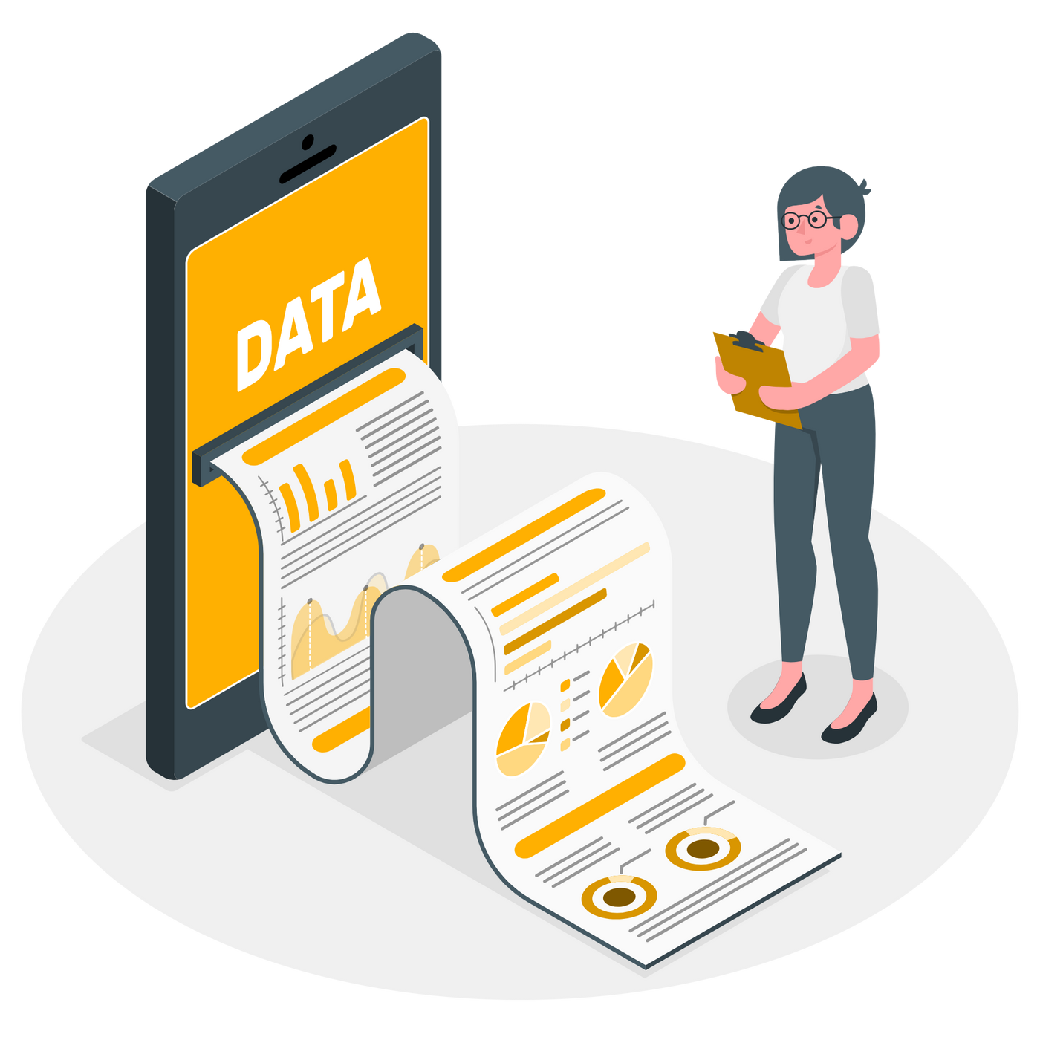
AI
ML
RL
DL
ML ?!
Machine Learning is a technique to implement AI that can learn from data by themselves without being explicitly programmed

Slide 5

ML Types
AI
ML
RL
DL
Supervised Learning
Unsupervised Learning
ML algorithms learn from labelled Data
ML algorithms learn from Unlabelled Data
Reinforcement Learning
Here the agent learns how to make the best decision = the action that maximize its rewards

Slide 6
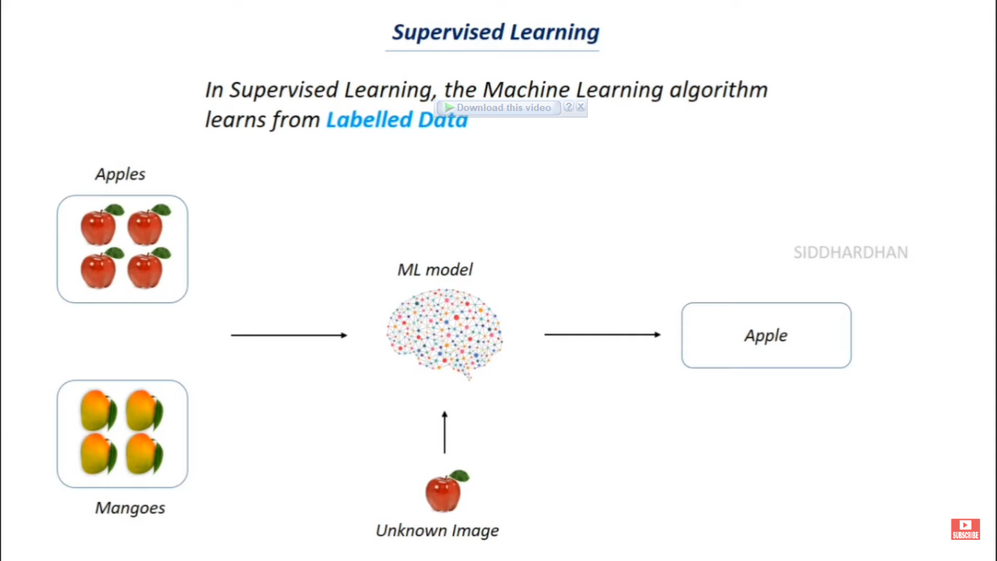
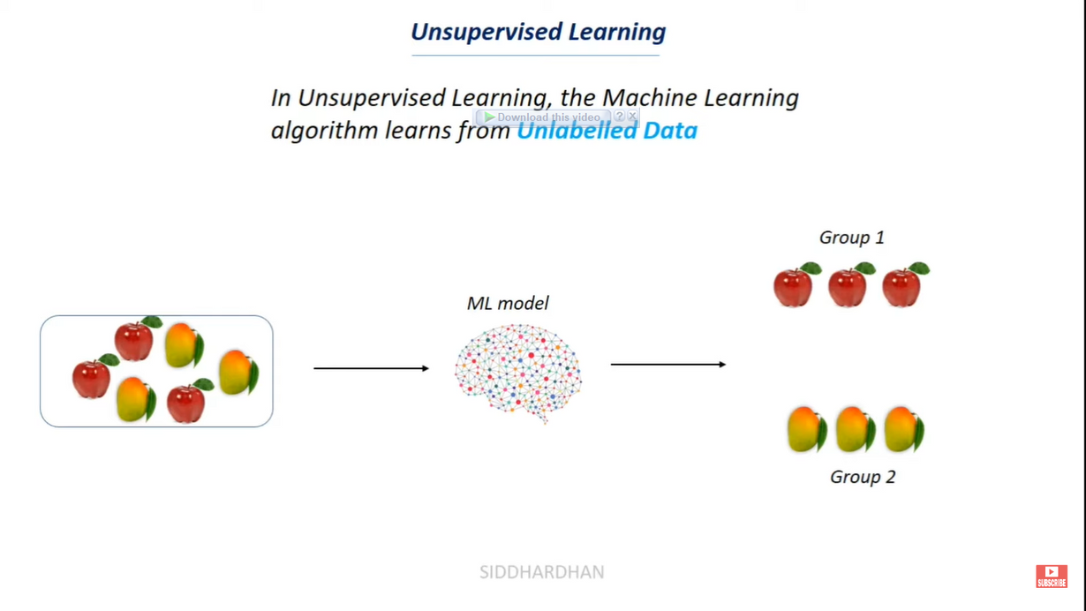
ML Types
AI
ML
RL
DL
Supervised Learning
Unsupervised Learning

Slide 7
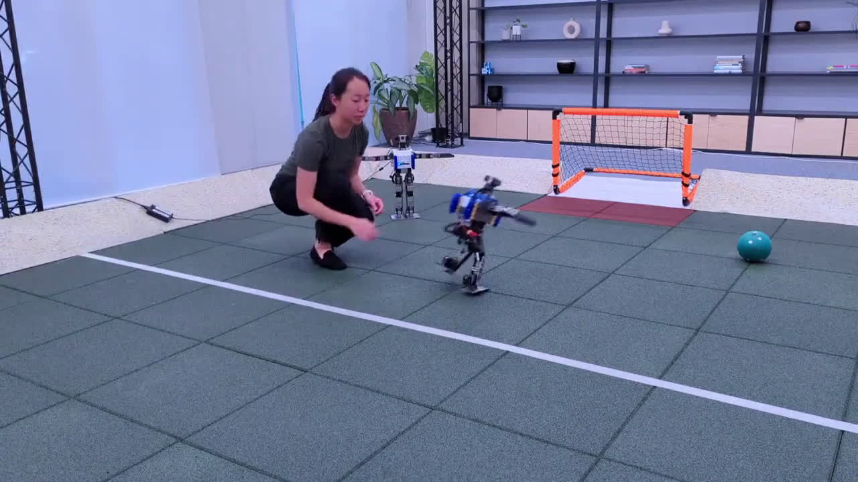
ML Types
AI
ML
RL
DL
Reinforcement Learning

Slide 8







SL Types
AI
ML
RL
DL
Classification
Regression
Supervised Learning
Predicting a class from a set of classes => discrete values
Predicting continuous values

Slide 9

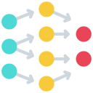
AI
ML
RL
DL ?!
DL
Deep learning is a subfield of ML that uses Artificial Neural Networks to learn from data.

Slide 10




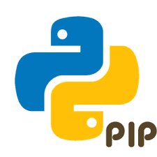

Programming Toolbox

Slide 11







Web?!
2
Large community
Hosting
Web app to desktop app
Web app to mobile app

Slide 12






Workflow?!
Python tips and tricks
2
Bonus Delight
Working on our project
1
AI tools

Slide 13

Our first project

Slide 14




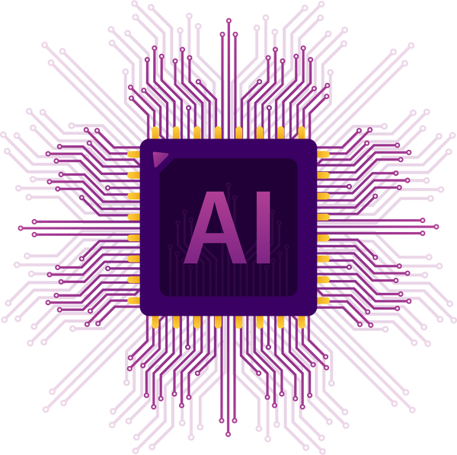




Our first project

Slide 15
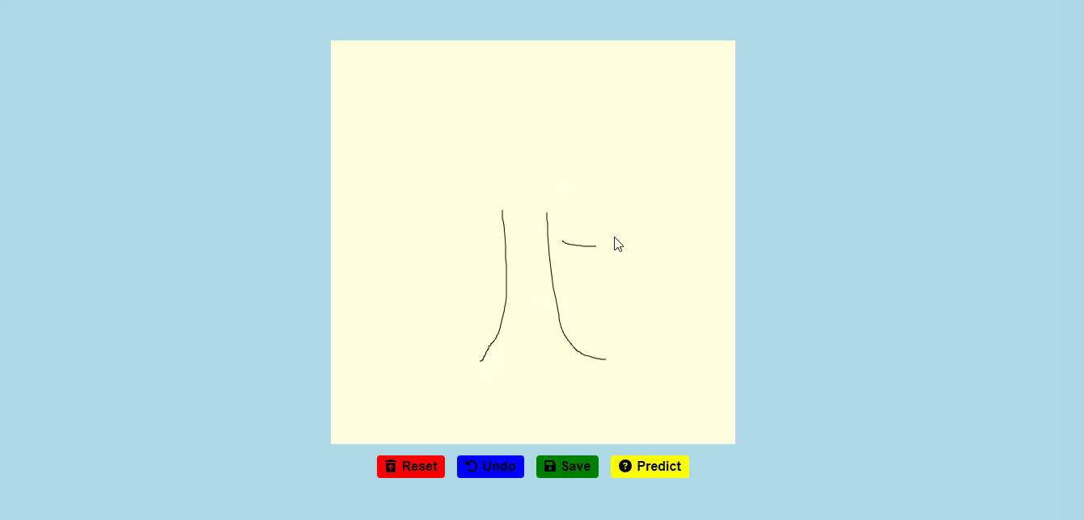

Slide 16

Our First Project
WHAT WILL WE LEARN BY COMPLETING THIS PROJECT?

Slide 17


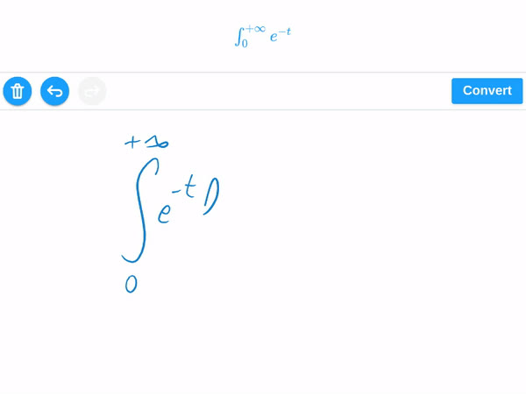
Extensions of our project?

Slide 18


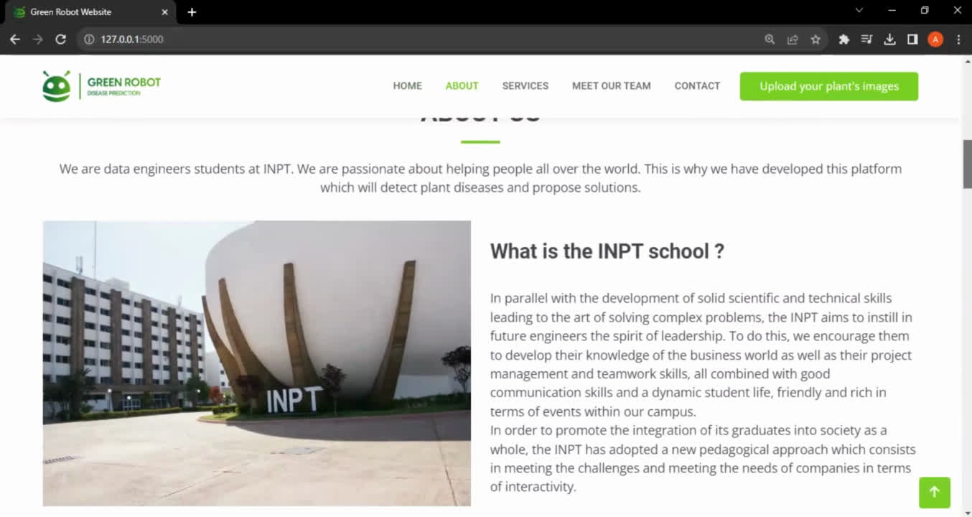
Extensions of our project?

Slide 19
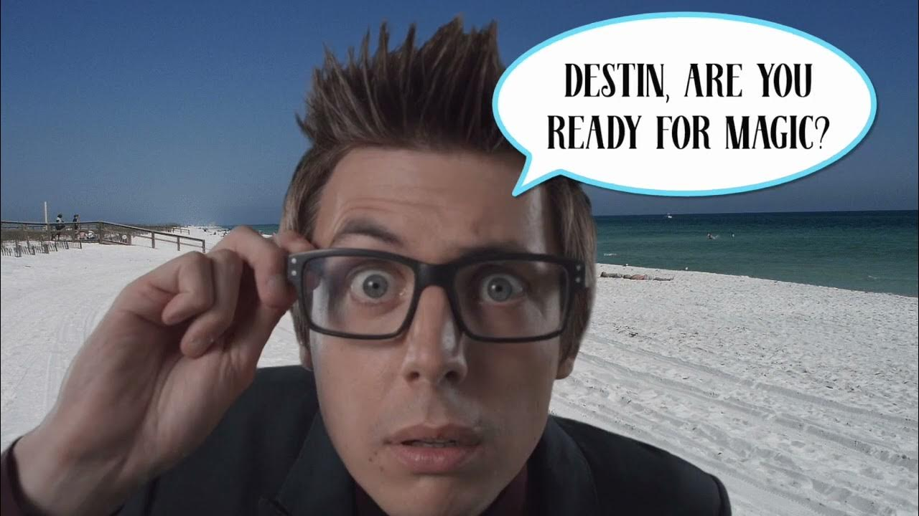
VS Code Magical Extension

Slide 20
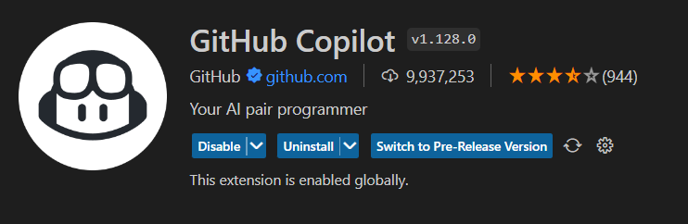
VS Code Magical Extension
GitHub Copilot

Slide 21
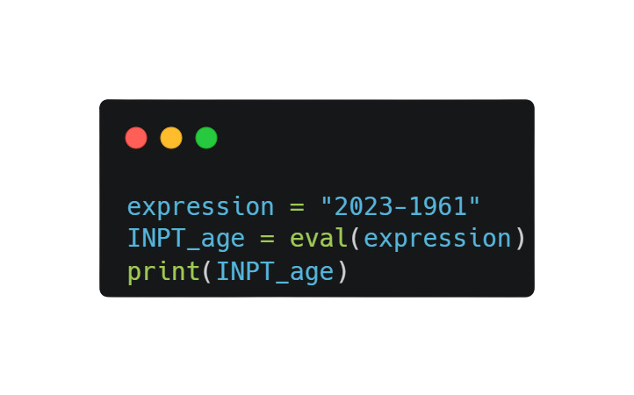

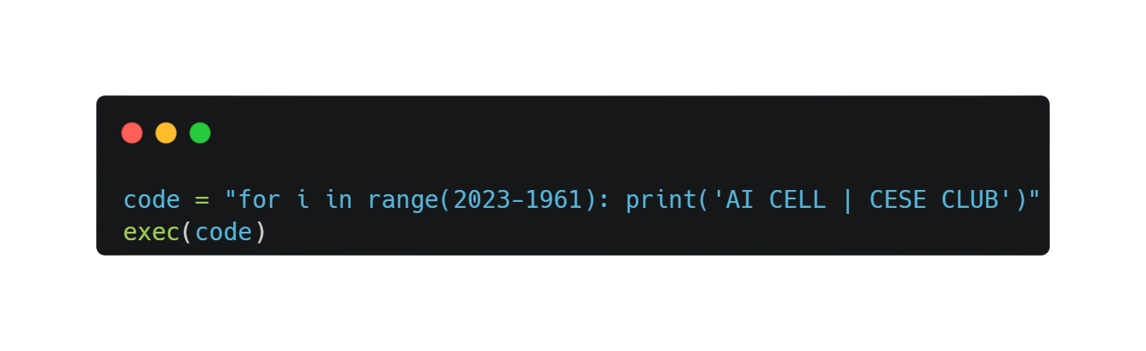
Python Tips&Tricks

Slide 22

Python Tips&Tricks

Slide 23

THANK
YOU FOR
YOUR ATTENTION

